Slide 1


Agentic AI for
Health and Academic Research
Notes:
Introduce the purpose: not a full textbook, but a ready-to-teach starter deck that can be expanded into handouts or video scripts.

Slide 2
Agents- Concepts

Slide 3
Agentic AI for Health and Academic Research
Agentic AI: Concept, tools, and how to create agents
Agentic AI = an AI system that can plan, use tools, remember context, check results, and hand work to specialist agents under human-defined boundaries.
Goal
Plan
Tools
Act
Verify
Human OK
Core building blocks
Popular frameworks
Classroom creation recipe
• Model with clear role/instructions
• Tools: search, database, code, calendar, document reader
• Memory/state for continuity
• Guardrails: privacy, safety, validation
• Handoffs or sub-agents for specialist tasks
• OpenAI Agents SDK: agents, tools, handoffs, guardrails
• LangChain/LangGraph: tool calling and orchestration
• CrewAI: role-based multi-agent workflows
• Microsoft Agent Framework/AutoGen lineage: multi-agent patterns
1. Define a narrow task and success criteria
2. Choose tools and data sources
3. Write the agent instruction
4. Add checks, citations, and human approval
5. Test with 5–10 real scenarios before deployment
Notes:
Teaching prompt: contrast a chatbot and an agent. A chatbot answers; an agent completes a bounded workflow with tools and checks.

Slide 4
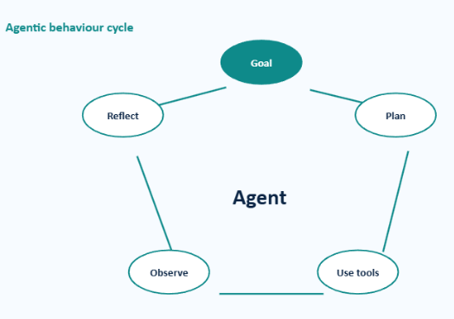
What is Agentic AI?
From response generation to goal-oriented action
Core idea
Agentic AI refers to AI systems that can understand a goal, plan steps, use tools, act on information, and refine their output with limited human intervention.
Classroom explanation
Ordinary AI chatbot
Agentic AI system
Answers questions or generates content based on a prompt.
Works through a task: plans, uses tools, checks progress, and completes a goal.
Key components
Goal: final task to achieve
Tool use: calls external systems
Planning: breaks goal into steps
Reasoning: chooses next action
Takeaway: Agentic AI = AI that can plan, use tools, act, and improve its response to achieve a goal.
Memory: keeps context
Reflection: checks quality

Slide 5
How Agentic AI Works
Architecture, tools, and creating simple agents
Basic architecture
User / Researcher / Health Worker
Agent Interface
LLM / Reasoning Engine
Planner + Memory + Safety Rules
Tools + Knowledge Base
Reason–act–observe loop
User Goal → Agent Reasoning → Plan → Tool Use → Observation → Reflection → Final Output / Next Action
Common tools connected to agents
Search
Database
Python
Spreadsheet
EHR / Health app
Literature DB
How to create a simple AI agent
Main building blocks
Foundation model understands language and generates responses.
Prompt layer defines the role, limits, and task style.
Planner, memory, tools, knowledge base, and guardrails make it agentic.
Human-in-the-loop review is essential in health and research.
1. Define purpose
5. Set workflow
2. Define user & context
6. Add safety rules
3. Define inputs
7. Test with cases
4. Choose tools
Mini example: Research Design Assistant → converts a broad idea into objectives, variables, methods, ethical issues, and a faculty-review-ready plan.

Slide 6
Tools for Agents

Slide 7
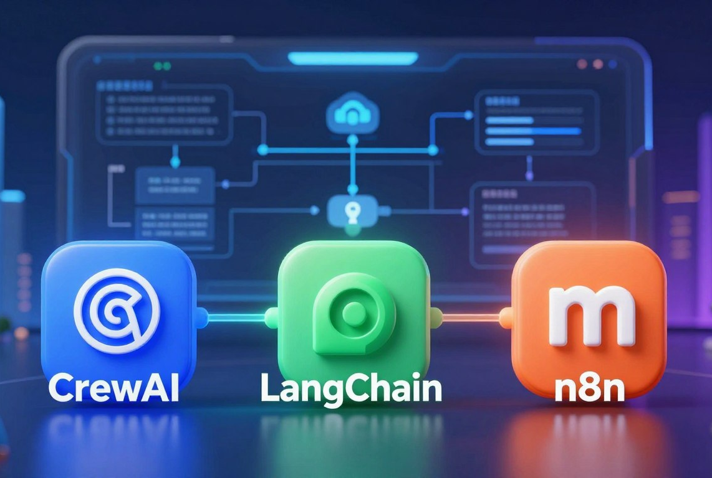
Tools for Building Agentic AI
Agentic AI for Health & Academic Research
Choose the tool based on the job: visual workflow, coding framework, model layer, memory, app integration, or safety.
1. Visual / low-code workflow builders
2. Developer frameworks for agents
n8n: AI Agent workflows with tools
Zapier AI / Make: app automation
Flowise: visual LLM app builder
LangChain + LangGraph
CrewAI: role-based multi-agent teams
Microsoft AutoGen; Google ADK
3. Model + agent platforms
4. Memory, knowledge and retrieval
OpenAI Agents SDK / API
Anthropic Claude tools / MCP
Gemini / Vertex AI Agent Builder
Vector DBs: Pinecone, Weaviate, Chroma
RAG over PDFs, datasets, guidelines
SQL / Sheets / institutional databases
OpenAI Agents SDK
Google ADK
Microsoft AutoGen
Zapier AI / Make
5. Integration, deployment and safety
FastAPI, webhooks, Docker, cloud hosting, logging, evaluation, guardrails, human approval and audit trails

Slide 8
1. What n8n Adds to Agentic AI
Agentic AI for Health & Academic Research
From “AI gives an answer” to “AI runs a visible workflow with tools, data, checks, and actions.”
n8n in one line
Input
Form / Chat
AI Agent
Reason + decide
Tools
Search / Sheets / API
Logic
IF / rules / review
Output
Report / Alert
n8n is a low-code workflow automation platform where every step is represented as a node on a visual canvas. For agentic AI, this means the agent can reason, call tools, pass data, and trigger actions in a transparent way.
Why useful for teaching
Why useful for research
Why useful for health
Visual workflow canvas
Connects apps, APIs and databases
Can use AI Agent nodes with tools
Can be self-hosted or cloud-based
Learners can see the workflow, not just hear theory.
Tasks can be broken into steps: collect, verify, analyze, write.
Rules, review points, and data sources can be made explicit.
Teaching hook
Think of it as a “lab bench” where the AI brain is connected to instruments.
Key message: n8n does not replace the AI model. It gives the model a controlled workflow, tools, and action path.

Slide 9
2. Anatomy of an n8n AI Agent Workflow
Agentic AI for Health & Academic Research
A practical agent is a workflow: trigger → model → tools → memory → output → human review.
1
Trigger
2
AI Agent
3
Chat Model
4
Tools
5
Memory
6
Action
7
Review
Trigger
AI Agent
Chat Model
Tools
Memory
Action
Review
Chat message, form, webhook, email, schedule
Receives goal; decides next step
OpenAI, Anthropic, Mistral, Groq etc.
Gmail, Sheets, HTTP, DB, search, code
Conversation context and session data
Send report, update sheet, create alert
Teacher, researcher, clinician approves
Good agent design question
Reliable agent rule
Safety rule
“What should the AI decide, and what must remain under human control?”
Use tools for facts, calculations, data retrieval, and repeatable actions.
For health and research: cite sources, protect data, and add expert review.

Slide 10
3. Build Your First Agent in n8n: Step-by-Step
Agentic AI for Health & Academic Research
Example target: a “Research Assistant Agent” that receives a topic and returns a structured research plan.
Step 1
Create a workflow
Step 2
Add a trigger
Step 3
Add AI Agent node
Open n8n → New Workflow → name it clearly, e.g., Research Assistant Agent.
Use Chat Trigger for live demo, Form Trigger for learners, or Schedule/Webhook for automation.
Write the role: “You are a research support agent for CS faculty and PhD scholars.”
Step 4
Attach chat model
Step 5
Attach tools
Step 6
Add output action
Connect OpenAI / Anthropic / other supported model credentials. Keep temperature moderate.
Add search, Google Sheets, database, HTTP Request, or document tools depending on the task.
Send email, update spreadsheet, create document, or return answer to chat.
Starter prompt: “Given the topic, create research objectives, possible variables, suggested method, expected data source, ethical issues, and a faculty-review checklist.”

Slide 11
4. Configuring the Agent: Instructions, Tools, and Memory
Agentic AI for Health & Academic Research
The quality of the agent depends less on the logo of the model and more on workflow discipline.
A. Agent Instructions
B. Tools
C. Memory + Guardrails
Role: who the agent is
Task: what it must produce
Boundaries: what it must not do
Format: table, report, checklist
Escalation: when to ask human
Google Sheets: store responses
HTTP Request: call health/research APIs
Database: fetch institutional data
Search tool: gather web context
Code node: clean or transform data
Use session ID for conversation continuity
Limit what memory stores
Protect personal / patient data
Add expert approval before action
Log outputs for audit
Example: “Do not give medical diagnosis. Provide risk explanation and recommend clinician review.”
Rule of thumb: use a tool whenever the answer needs current data, exact calculation, or system action.
For classroom demo, use sample or synthetic data. Real data = consent, privacy, and ethics first.
Teaching point: an agent is a workflow with a brain, hands, memory, rules, and a supervisor. That last part saves everyone from chaos goblin mode.

Slide 12
Classroom Demo Blueprint: Research or Health Agent
Agentic AI for Health & Academic Research
Use this as a hands-on design activity: learners build the workflow logic before building the automation.
Demo workflow: “Wellness Follow-up Agent”
Learner task: build an agent card
Patient form
BP, sugar, sleep, activity, mood
Purpose
Tools
What goal will the agent achieve?
Which apps, databases, APIs, or files will it use?
AI Agent
Classifies risk + explains
Users
Risks
Who will use it? Faculty, scholar, patient, health worker?
What can go wrong? Bias, privacy, hallucination, unsafe advice?
Tools
Risk sheet + guideline notes
Inputs
Review
What data enters the workflow?
Who approves the final output?
Decision
Low / moderate / high risk
Output
Patient message + health-worker alert
Assessment output: one workflow diagram + one agent instruction prompt + one safety checklist.
Human-in-loop: clinician / researcher validates before real-world action.

Slide 13
Agentic AI for Health and Academic Research
Case Study: Agentic AI for digital health and community wellness
Use case: a community digital-health assistant that turns field data into risk stratification, personalized feedback, follow-up reminders, and caregiver support.
Field data
Risk engine
Feedback agent
Care plan
Review
Agent roles
Human-in-the-loop safeguards
Class activity
• Intake Agent reads vitals, symptoms, PHQ-9/GAD-7, lifestyle inputs
• Risk Agent computes wellness-risk category and flags missing values
• Feedback Agent drafts simple, culturally appropriate advice
• Follow-up Agent schedules reminders and escalates red flags
• No independent diagnosis or prescription
• Nurse/doctor approval for escalation
• Consent-based data access
• Explainable risk reason: “why this feedback?”
• Referral path for severe distress or emergency signs
Give each group a sample patient profile. Ask them to design: agent goal, tools, input data, output format, safety checks, and evaluation metric. Bonus: add a caregiver-support micro-agent.
Notes:
Connect this to the SPARC RHealth idea: grounded data, community context, behavioral theories, and responsible digital health design.

Slide 14
Case Study: Inpatient Risk Alert Agent for Nurse Station
Case Title
WardWatch Agent: An Agentic AI System for Alerting Nurse Stations Using Hospital ERP Data
Problem Context
In hospitals, admitted patients generate a lot of data through the hospital ERP or Hospital Information System. This may include admission details, diagnosis, vitals, medication schedule, lab results, nursing notes, doctor orders, and patient complaints.
However, nurses may be handling many patients at the same time. A warning sign may be hidden inside routine entries such as abnormal vitals, missed medication, delayed lab results, sudden deterioration, or repeated patient complaints.
An Agentic AI system can continuously monitor admitted-patient data from the ERP and alert the nurse station when a patient needs attention.

Slide 15
Case study- Health

Slide 16
Case Study: Inpatient Risk Alert Agent for Nurse Station
Agent Goal
The agent helps the nurse station by:
monitoring admitted-patient data, identifying risk patterns, prioritizing cases, and sending timely alerts for human review and action.
ERP Data Source | Example Data
Patient profile | Age, gender, ward, bed number, diagnosis
Vital signs | Temperature, BP, pulse, SpO₂, respiratory rate
Medication records | Scheduled medicines, missed doses, delayed administration
Lab results | Blood sugar, Hb, WBC count, creatinine, electrolytes
Doctor orders | New orders, pending investigations, escalation notes
Nursing notes | Pain, dizziness, vomiting, confusion, fall risk
Admission details | Post-surgery, ICU step-down, high-risk category
Device data | Monitor readings, oxygen support, infusion status

Slide 17
Case Study: Inpatient Risk Alert Agent for Nurse Station
Hospital ERP / HIS Data Update
n8n Webhook or Database Trigger
Fetch Patient Data
Check Missing / Abnormal Values
AI Agent Node + Clinical Rule Engine
Classify Risk: Green / Yellow / Orange / Red
Send Alert to Nurse Station
Record Alert in ERP / Dashboard
Nurse Acknowledgement and Follow-up Update

Slide 18
Case Study- Academic Research

Slide 19
Agentic AI for Health and Academic Research
Case Study: Agentic AI for academic research workflows
Use case: a research co-pilot that supports literature mapping, research design, data-analysis planning, writing, publication targeting, and grant workflows.
Literature Scout
Method Mentor
Analysis Planner
Writing Coach
Publication Agent
Search + screen papers
Refine aim, design, variables
Suggest tests + reproducibility
Draft sections + check logic
Journal fit + ethics checklist
Example workflow
Good research conduct
Mini demo prompt
Topic: “adaptive interventions in programming education.”
The agent builds a concept map, identifies measurement variables, proposes a study design, drafts a data-analysis plan, checks reporting guidelines, and produces a transparent research log.
• Cite every factual claim
• Keep raw data private
• Make analysis scripts reproducible
• Use AI for support, not ghost authorship
• Maintain researcher judgement throughout
“Act as a research-design agent. Given my topic, generate a PICO/PEO-style research question, 5 search strings, inclusion criteria, variables, and a one-page analysis plan. Ask for missing details only after giving a draft.”
Notes:
Emphasize that agentic AI is strongest when it creates traceable, reviewable steps rather than black-box answers.

Slide 20
Case title: Research Radar Agent Using n8n
Problem: Researchers may miss newly published articles because manual searching across Google Scholar and databases is irregular and time-consuming.
Agent Goal: Automatically detect new articles in a defined research area, filter them using keywords and AI-based relevance scoring, and send a monthly digest.
Inputs: Research keywords, Google Scholar Alerts, article titles, abstracts, DOI links, publication date, journal name, and previously stored articles.

Slide 21
Assessments

Slide 22
Agentic AI for Health and Academic Research
Assessment: design one agentic AI case study
Group task: choose one case, design the agent workflow, and present a 5-minute “minimum viable agent” blueprint.
Expected output
Scoring rubric: 20 marks
Presentation format
• Problem statement
• User/stakeholder
• Agent goal and boundaries
• Input data + tools
• Workflow diagram
• Guardrails and human review
• Evaluation metric
Problem clarity – 3
Agent design – 5
Tool/data fit – 4
Ethics & safety – 4
Feasibility + presentation – 4
Slide 1: Problem + users
Slide 2: Agent workflow
Slide 3: Tools, guardrails, evaluation
Demo optional: prompt, pseudo-code, or flowchart
Rule of thumb: AI may assist, but the group must defend every design choice. No autopilot academics, please.
Notes:
Use this as the instruction slide before group work. Encourage groups to keep their design grounded and practical.

Slide 23
Agentic AI for Health and Academic Research
Assessment Case Studies
Case 1: Community Diabetes Follow-up Agent
Case 2: Mental Health & Caregiver Support Agent
Context: A health team collects BP, glucose, BMI, diet, activity, medication adherence, and distress indicators from adults in a panchayat.
Task: Design an agent that identifies follow-up priority, drafts personalized feedback, and alerts the health worker when clinical review is needed.
Must include: red-flag rules, consent, data-minimization, and one evaluation metric.
Context: A digital health app includes PHQ-9/GAD-7 screening and caregiver input for chronic illness patients.
Task: Design a support agent that provides empathetic psychoeducation, caregiver tips, and referral prompts without diagnosing or replacing professionals.
Must include: crisis-escalation path, tone guide, privacy boundary, and human approval step.
Notes:
These two cases are health-focused and align closely with Sessions 3 and 4.

Slide 24
Agentic AI for Health and Academic Research
Assessment Case Studies
Case 3: Literature Review & Knowledge Map Agent
Case 4: Manuscript & Grant Workflow Agent
Context: A PhD scholar wants to review research on adaptive learning interventions in programming education.
Task: Design an agent that searches literature, screens papers, extracts constructs, builds a concept map, and prepares a review matrix.
Must include: citation verification, inclusion/exclusion criteria, bias check, and audit trail.
Context: A faculty team has completed data analysis and needs a manuscript, target journal shortlist, response-to-reviewer draft, and grant concept note.
Task: Design an agentic workflow that coordinates writing, formatting, journal matching, compliance checks, and version control.
Must include: authorship ethics, plagiarism prevention, source tracking, and PI approval.
Notes:
These two cases align with Sessions 5 and 6. Ask learners to identify where agentic AI genuinely helps and where human judgement remains essential.

